Slide 1
CancerWise
(Lung Cancer Predictor)
Arijit Singh
User Manual

Slide 2
1)Acknowledgements
2)About Me
3)About Internship Journey
4)About App
5)How to use the App
6)Conclusion
Table of Content

Slide 3
Introduction
This presentation covers the key aspects of the app development project.
It highlights the introduction, acknowledges contributors,
and summarizes the internship experience and app creation process.

Slide 4
Acknowledgements
I would like to extend my deepest gratitude to all those who have supported me throughout the development of this project.
First and foremost, to my parents, for their constant encouragement and unwavering support, which provided the foundation for all my endeavors.
I am also incredibly grateful to my mentors, Mr. Avishek and Mr. Ken, for their invaluable guidance, expert insights, and dedicated mentorship. Their feedback and wisdom were crucial to navigating the complexities of this project.
This work is a testament to the collective effort and support of my family and mentors, and I am sincerely thankful for their belief in my potential.

Slide 5

About Me
My name is Arijit Singh, a student of Grade 12th .
As a passionate student developer, I am deeply committed to leveraging artificial intelligence for social good. I believe in creating technology that is not only innovative but also accessible and impactful. The development of CancerWise was an opportunity to apply my knowledge in machine learning to a critical healthcare challenge, aiming to provide a user-friendly tool that promotes health awareness.

Slide 6
Internship Experience Overview
My internship at Clevered was a transformative and enriching experience that laid the groundwork for the development of my lung cancer risk prediction project. This journey was about much more than just learning to code; it was about gaining a comprehensive understanding of the entire app development lifecycle, from concept to deployment.

Slide 7
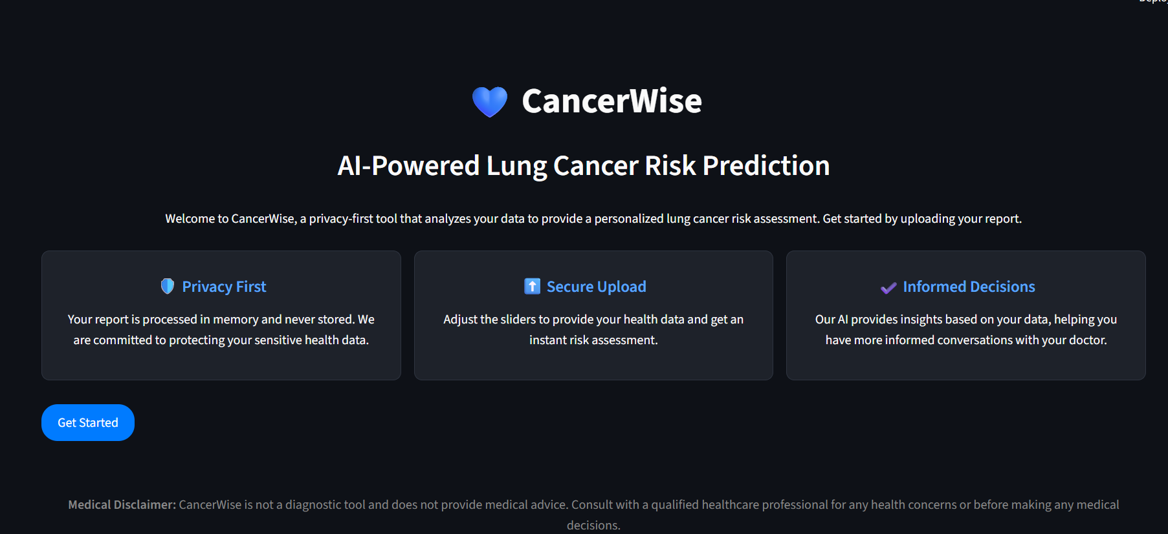
Introduction to the App Project
CancerWise is a privacy-first, interactive application designed to provide a preliminary assessment of an individual’s potential risk for lung cancer. The app's main goal is to empower users by making a complex health topic accessible and understandable.

Slide 8
App Overview and Usage
The CancerWise app is designed to be user-friendly, guiding you through a simple, three-step process to get your personalized risk assessment.
Step 1: Input Your Data On the initial screen, you will find a questionnaire with a series of interactive sliders and a dropdown menu. Use the sliders to input data for various risk factors, such as Age, Smoking, Coughing, Chest Pain, and others. For each slider, you can hover over the (?) icon to see a detailed description of what the numerical scale from 1 to 9 represents. Select your Gender from the dropdown menu.
Step 2: Get Your Prediction Once you have adjusted all the sliders and selected your gender, click the "Get Prediction" button at the bottom of the screen. The app will then process your data using its machine learning model.
Step 3: View Your Results After a brief moment, the app will navigate you to the "Analysis Results" screen. Here, you will see your "Predicted Risk Level" (Low, Medium, or High). The screen also displays a clear bar chart, visually showing you the "Top Features Influencing Risk" in your specific case. This provides transparency by highlighting which of your entered data points had the greatest impact on the prediction.

Slide 9
App Main Menu and Features
Description: This is the first screen a user sees. It’s the app’s home page and main entry point.
Steps to Use: Simply click the “Get Started” button to head over to the Questionnaire page

Slide 10
Step-by-Step Usage Instructions for Patient Information Questionnaire
Description: This screen contains the interactive sliders and dropdown menu for user data input. It's the core data collection screen of the app.
Steps to Use:
Use the "Age" slider to input your age.
Select your "Gender" from the dropdown menu.
For all other risk factors (e.g., Smoking, Chest Pain, Air Pollution), use the sliders to rate your personal exposure or symptom severity.
Hover over or click the "?" icon next to each slider for a detailed explanation of what the numerical scale represents.
Once you've entered all your information, click the "Get Prediction" button at the bottom of the screen.
Special Considerations/Dependencies:
The values you select are directly used as input for the underlying machine learning model, so accurate input is critical for an accurate prediction.

Slide 11
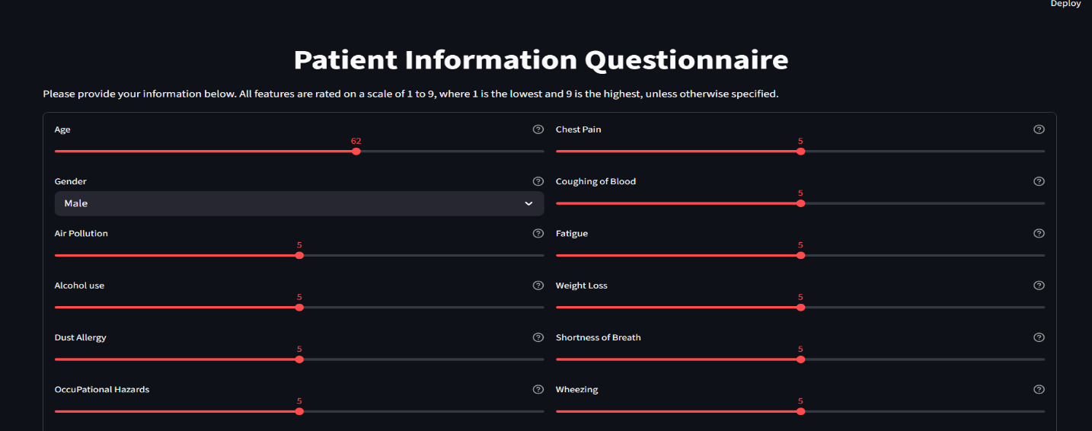
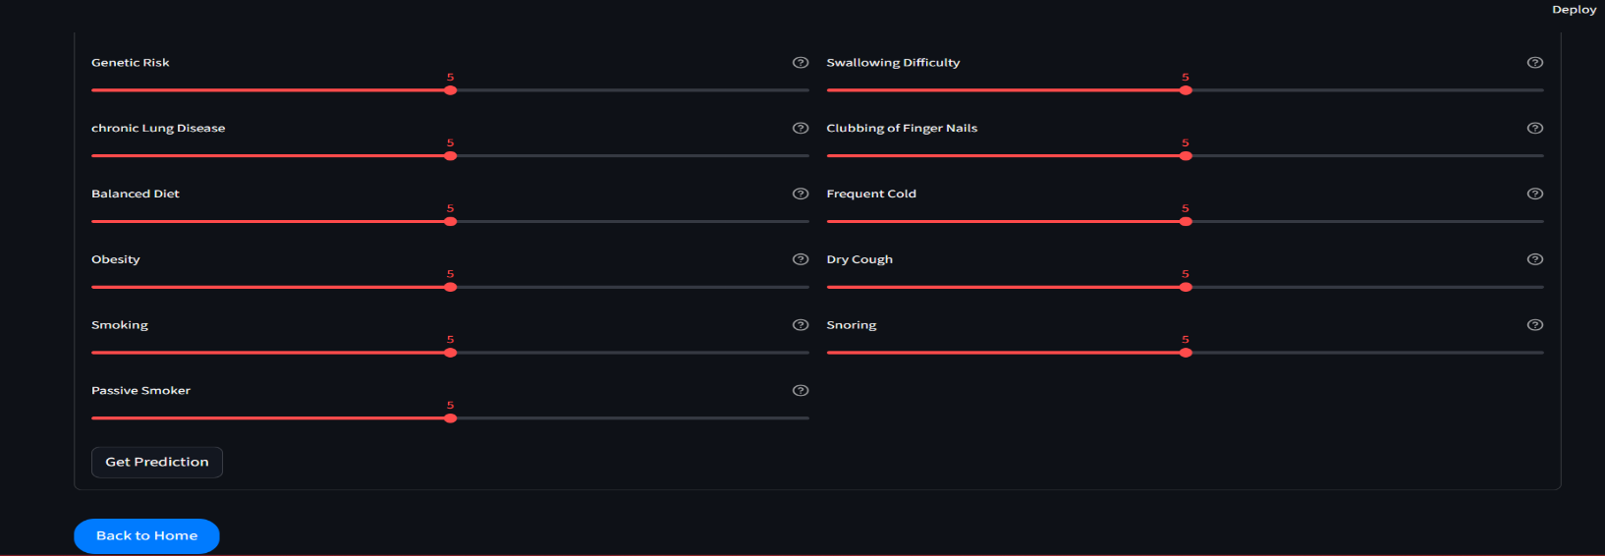
Step-by-Step Usage Instructions for Patient Information Questionnaire

Slide 12
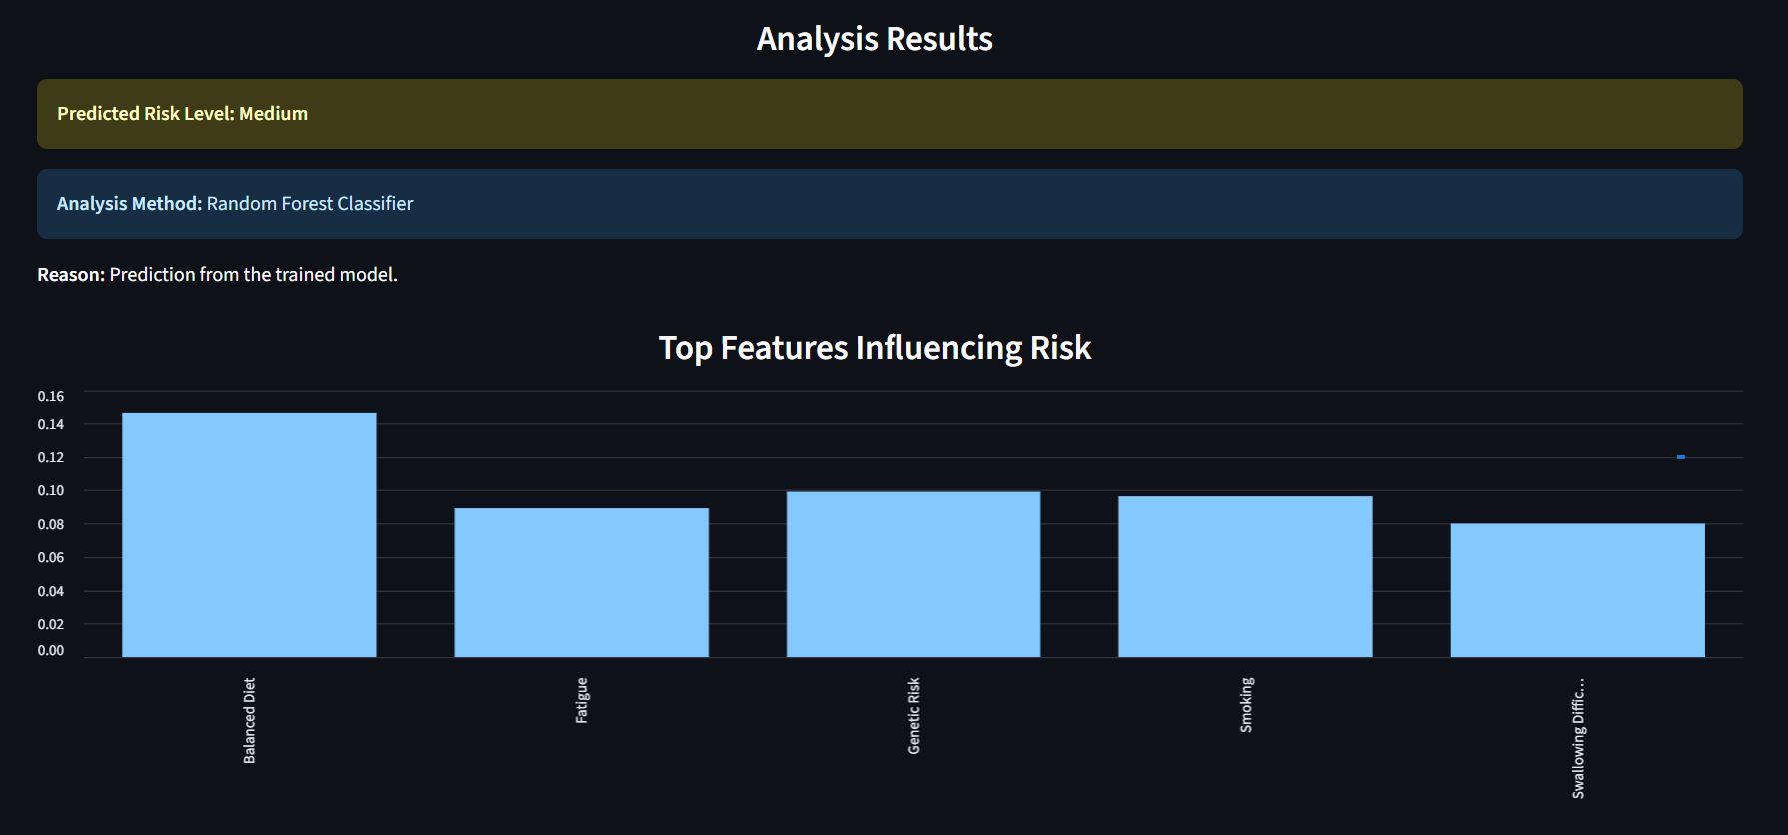
Step-by-Step Usage Instructions for Analysis Results Screen
Description: This screen displays the output from the machine learning model, providing a clear summary of the prediction.
Steps to Use:
This screen loads automatically after you click "Get Prediction."
Read your "Predicted Risk Level" to see your personalized assessment (e.g., "Medium").
View the "Top Features Influencing Risk" bar chart on the right. This chart helps you understand which of your personal factors contributed most significantly to your risk level.

Slide 13
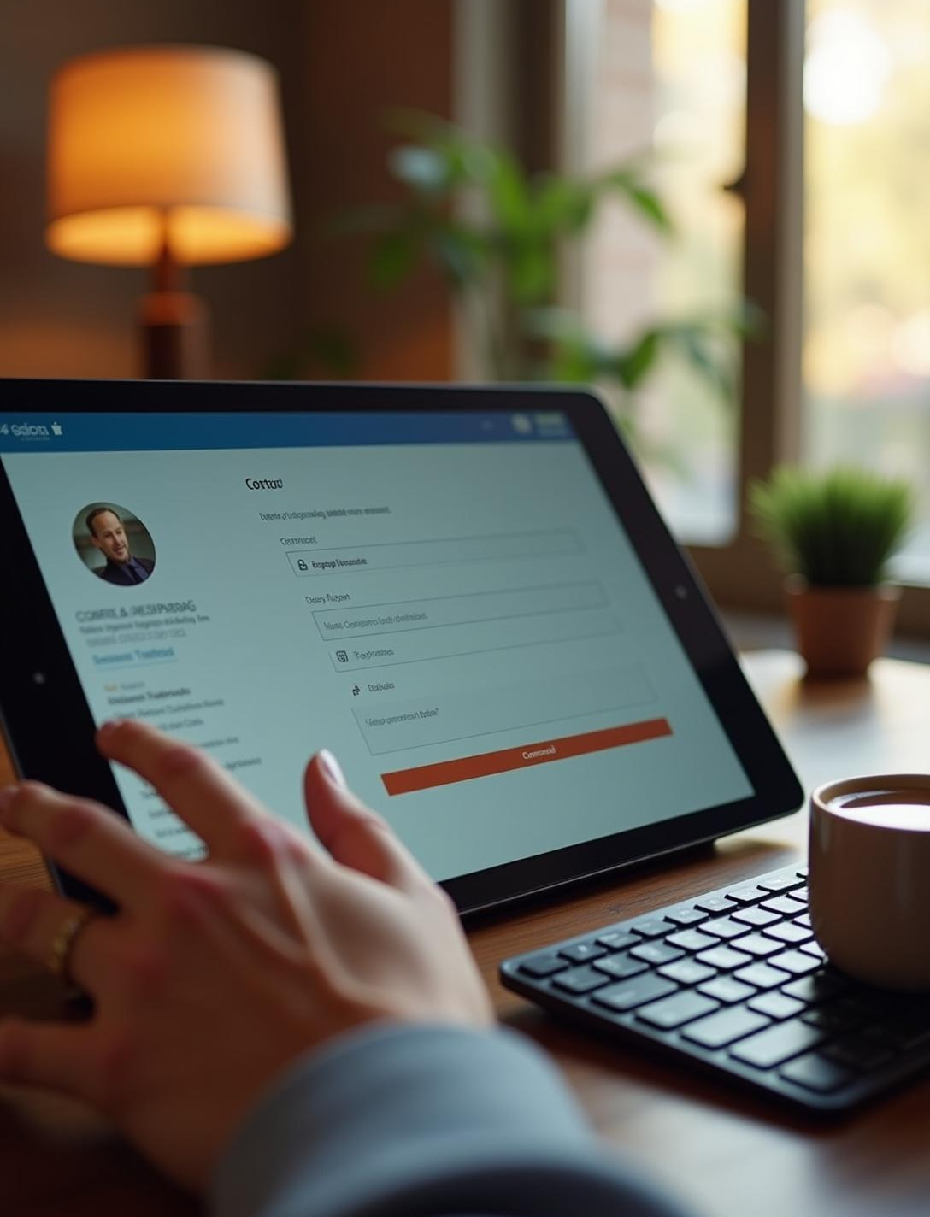
Contact Information
Name: Arijit Singh
Email: arijit.singhbais@gmail.com

Slide 14


